Slide 1
Remote Team Member’s Productivity Trends for Year 2025
Capstone – LGCC Data Analytics Cohort 6 (2025-2026)
Archana Shah

Slide 2

Python Libraries
Methodology: Use of Python to Analyze Dataset of 2025
Data Source:
Internal Confidential dataset
Import pandas as pd
Import numpy as np
File Type: CSV
Time period: 2025
Data- Frame Shape:
# Rows: 99203
# Columns: 15
Import seaborn as sns
Import matplotlib.pyplot as plt
Notes:
Download dataset
For Data cleaning involved
removing columns & rows
for start and completion date – business days and holidays are in consideration
Renaming Employee name due to confidentially
Analyzed using python through google Collab

Slide 3
Definitions
Clinical review: A medical professional reviews a proposed treatment or medication against insurance policy's coverage guidelines before care is provided. The goal is to ensure the treatment is medically necessary and covered.
Determination: The insurance company either approves or denies those request.
Notification: A formal communication (which includes verbal & Written) from health insurance company to member and provider confirming that they have received, reviewed, and have approved/denied a request from your doctor for a specific medication, procedure, or medical service. With verbal notification we must make 2nd attempt, if 1st attempt is unsuccessful.
*** Turn around time for these requests are 24 to 72 hours****

Slide 4
2025 Quantitative & Qualitative Metrics
Compare task completion volume & quality trends between team members
Tenure
Top performers – employee for 0-2 years
Under/average performers – employee for 5+ years
Notes:
As we see 2 of the Team members, Esha and Kavita, outperformed others in 2025 in the number of tasks completed.
Kavita’s # seem same compared to others but she started with company in March 2025.
3 Senior team members, Ethan, Irene and Harish were not “on pair” with the productivity of new team members while maintaining similar qualitative performance indicators.

Slide 5
Objectives
The Purpose of this project is to analyze the data to identify the productivity trends within the remote team, specifically:
Identify average time utilized to complete each task
Average time utilized to complete core tasks
Average total # of tasks completed by team members on daily as well as monthly basis
Determine factors influencing higher number of tasks not completed
Identify areas of opportunity to increase productivity

Slide 6
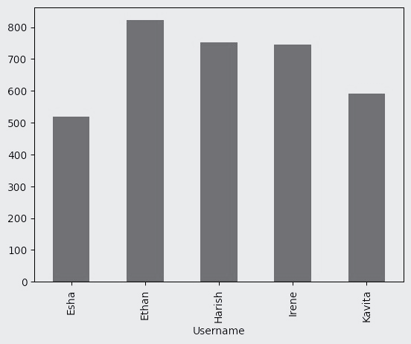
Overall Average Time Utilized to Complete a Task
Username | Average # of Minutes to Complete a Task
Esha | 518
Ethan | 822
Harish | 751
Irene | 746
Kavita | 591
Average Minutes to _complete task
Average time to complete a task was 685 mins
Esha & Kavita task completion was within 75 to 85 % of the average time
Irene, Harish & Ethan task completion was within 110 to 120 % of average time
Notes:
With this slide you see the average time utilized to complete each task.
From the data I analyzed, I pulled the times from when team started a task to times when team completed a task.
Average time to complete a task was 685 mins
2 of our new team members were within average time VS. 3 of our senior techs utilized way more time (about 120+ mins) than average time.

Slide 7
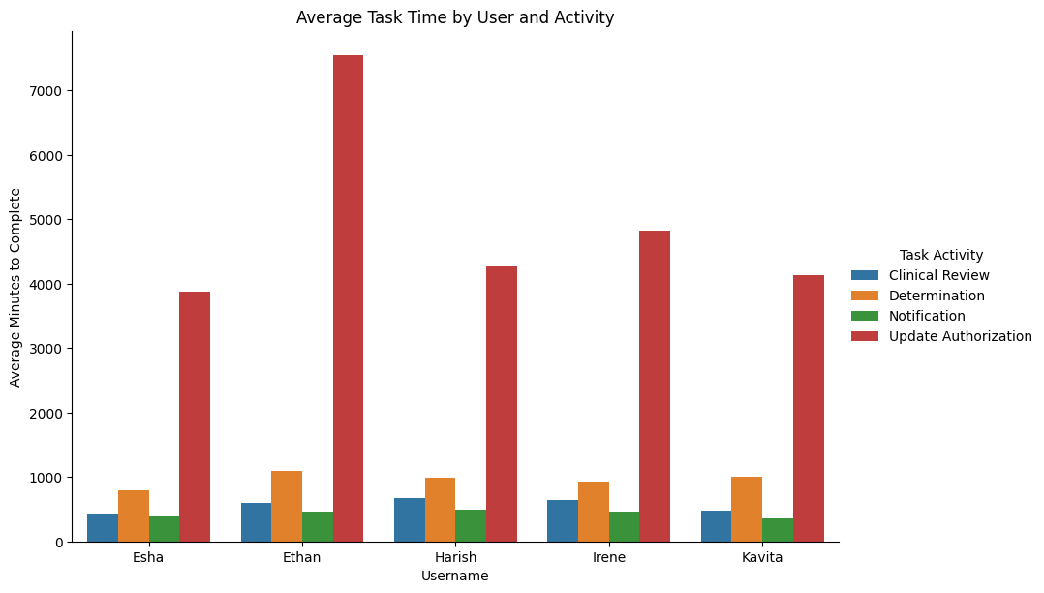
Average Time Utilized to Complete Core Tasks
Average time to complete Notification Task was 462 mins
Esha & Kavita - 75 to 85 % of average time
Ethan & Irene – little over but close to average time
Harish – 110 % of average time
Average time to complete Clinical Review Task was 577 mins
Esha & Kavita - 70 to 80 % of average time
Ethan – little over but close to average time
Irene & Harish – 110 to 115 % of average time
Notes:
Esha Ethan Harish Irene Kavita
Clinical Review 426.555981 598.872264 670.601695 646.063993 475.52385
Notification 383.929463 464.85274 498.771396 464.266084 352.407039
With that being said, Esha knocked out clinical reviews & Kavita knocked out notifications way faster than the rest of the team.

Slide 8
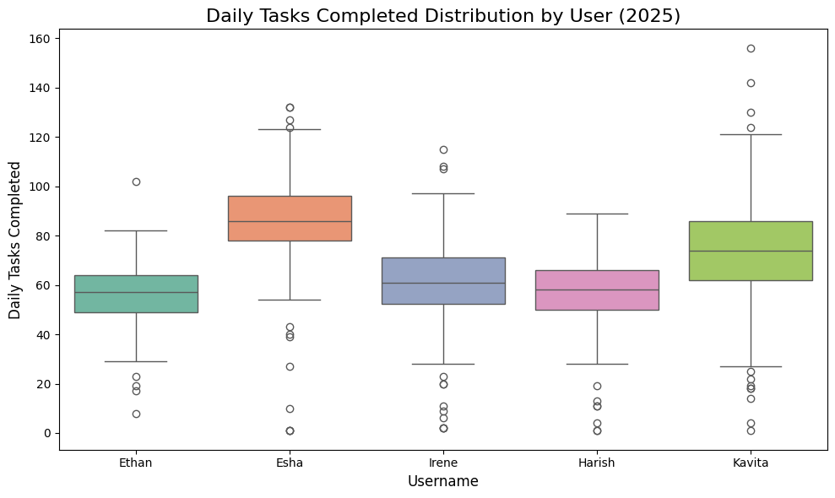
Average Total # of Tasks Completed by Team Members on Daily Basis
Username | Average_Daily_Tasks
Esha | 86
Ethan | 56
Harish | 57
Irene | 61
Kavita | 73
Average Daily Tasks: 67
Esha & Kavita - 10 to 30 % more than number of average daily tasks
Irene, Harish & Ethan – 10 to 15 % less than number of average daily tasks

Slide 9
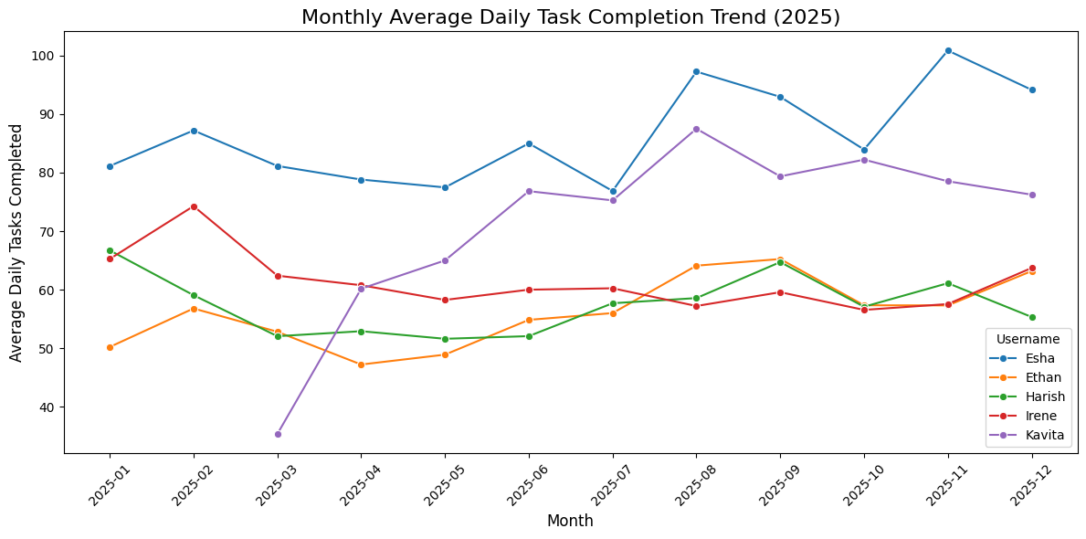
Average Total # of Tasks Completed by Team Members on Monthly Basis
When comparing the averages of monthly tasks completed by a team member, Esha has the higher number of tasks month by month followed by Kavita who started in March 2025 while Irene, Harish and Ethan’s productivity plateaued and were below Esha and Kavita’s.

Slide 10
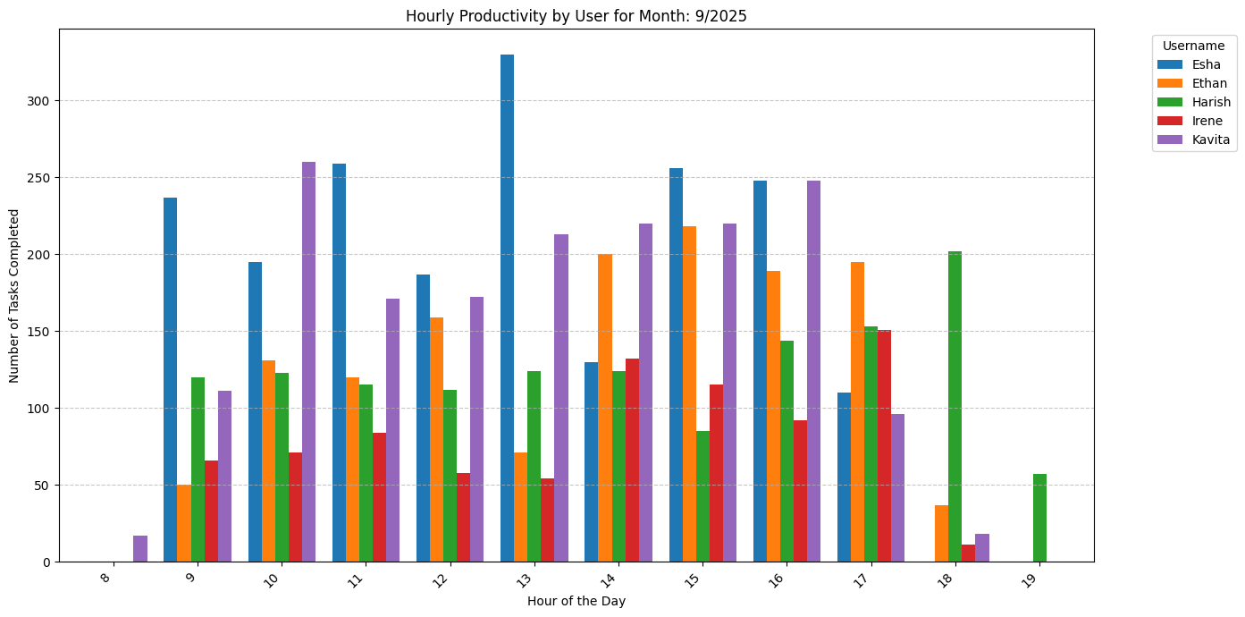
Hourly Productivity of Team Members for a Random Month
As you see on the graph Hourly productivity was consistent throughout the day for some of the users when compared to others.
Notes:
For this graph I have use data from month of September 2025
As you see on the graph Hourly productivity was consistent throughout the day for some of the users when compared to others.

Slide 11
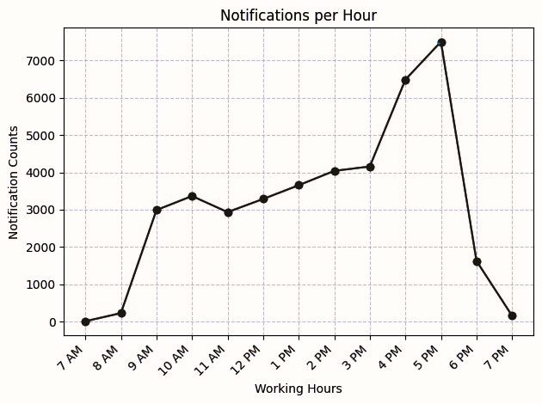
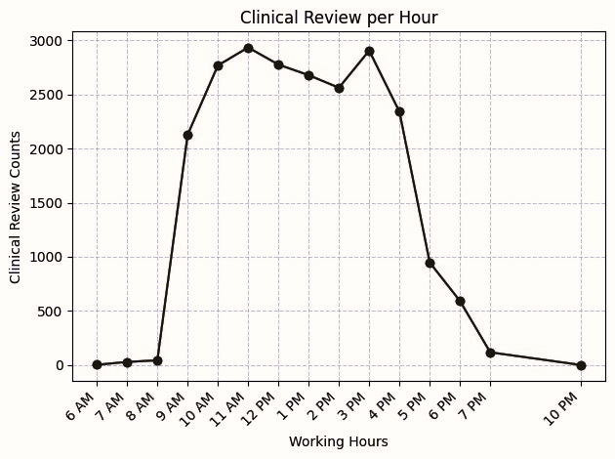
Notification & Clinical Review Task Comparison
Determine factors influencing higher number of tasks not completed
For Notification Task
Most productive hour: 17:00 PM
Least productive hour: 7:00 AM
For Clinical Review Task
Most productive hours: 11:00 AM & 15:00 PM
Least productive hour: 22:00 PM
*** Overall, low productive time within shift 9-5:30 was observed between 9 to 10 AM as well as 12 to 2 PM ***
Notes:
You must be wondering why are doing hourly comparison? As per CMS regulation we must review an authorization request within 24 to 72 hours which include clinical review, determination as well as notifications - all Must Happen within this define Turnaround time
Are we micromanaging? No – Normal business hours were 9 to 5:30 but graph shows least productivity outside of the business hours - as we believe in work balance life & allow flexibility in schedule if needed.
Determine factors influencing higher number of tasks not completed.”
Based on Notification chart – being more productive towards end of the day instead through out the day led us to higher # uncompleted 2nd attempt notification tasks – with that we can be at Compliance Risks
Based on Clinical Review chart - being least productive towards end of the day instead through out the day led us to higher # of uncompleted Clinical review tasks

Slide 12
Identify areas of opportunity to increase productivity
To maintain strict CMS 24 to 72-hour turnaround rules, workflows must be structured around CMS Prior Authorization timelines. The primary factors driving uncompleted tasks are misaligned scheduling and after-hours productivity spikes, which cause delays in required clinical reviews and 2nd attempt notifications.
Key Factors Causing Uncompleted Tasks
Misaligned Work Patterns: The data shows that productivity spikes at the end of the day rather than being evenly distributed. Because the 24 to 72-hour CMS clock ticks continuously, waiting until the late afternoon to process cases means there is insufficient runway to complete secondary steps (like final determinations or physician/member follow-ups).
Extended-Hour Dip: While offering a flexible work-life balance is ideal, the data highlights that task resolution drops significantly outside normal business hours. Working outside peak times may interrupt communication with medical offices or members.
Clinical Review Bottlenecks: Because clinical reviews demand rigorous medical necessity evaluations, attempting to tackle them at the end of the shift frequently leads to a backlog of uncompleted reviews and potential compliance risks.
Actionable Strategies to Prevent Compliance Risks
Shift Distribution: Consider implementing a morning-heavy queue for complex clinical reviews. Tasking your most productive hours (start of day) with the highest-risk, time-sensitive clinical items guarantees the team has a buffer to complete subsequent notifications.
Synchronous Case Management: Ensure 2nd attempt notifications are handled at pre-scheduled mid-day intervals. This removes the reliance on after-hours productivity, resulting in faster answers and less friction for both providers and member.
Task Segmentation: Separate "Notifications" from "Clinical Reviews" in the dashboard. Assign dedicated staff to continuous notification-clearing windows throughout the workday to avoid bottlenecks caused by waiting on the clinical review team.

Slide 13
For Team: Ownership, Accountability & Responsibility
Accountability
Responsibility
Ownership
Are you above or below the line?
Ownership
Accountable
Responsible
--------------------------------------------------------
Blame
Excuses
Denial
VICTOR
VICTIM
Ownership mindset & behavior
Doing the job Vs. achieving results
Blaming others Vs. taking accountability
Responsibility: a foundation for success
Notes:
On this slide, I would like to highlight some important traits of achieving productivity and quality set by the department and the organization.
Key factors are:
Ownership mindset & behavior - help us achieve individual as we as organization goal
Doing the job Vs. achieving results – keeps you motivated
Blaming others Vs. taking accountability – help us stay focus & growth.
Responsibility: a foundation for success – as successful individual makes successful department & organization

Slide 14
Factors & Strategies for remote leadership
Establish Clear Goals
Set roadmap
Provide resources
Clear communication
Trust & Empowerment
Transparency
Regular Check-ins
Periodic follow ups
Celebrate milestones
WorkiQ
Tracks time spent in work and non-work applications
Address challenges
Building relationships
Be adaptive and flexible
Measures idle time (e.g., breaks, lunch)
Shows overall activity patterns
Empower remote team members to take ownership of their work

Slide 15
Summary
Working remotely isn’t as easy as you think
Require lots of self control
Clear communication
Trust your people
When in doubt, speak openly
Care about the team
Support work-life balance

Slide 16

Questions

